Slide 1
Thermal Imaging

Slide 2
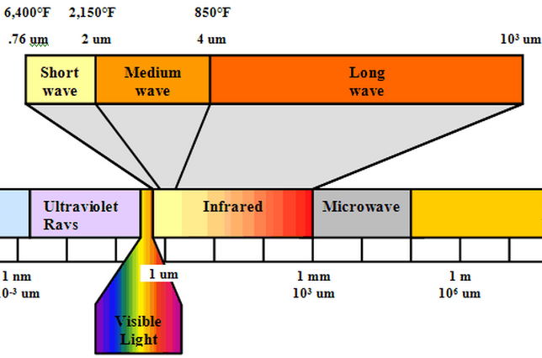
Infrared Energy
Everything emmits IR
Invisible to the human eye
The hotter something is the more infrared radiation it emmits
Longer wavelengths than visible light

Slide 3
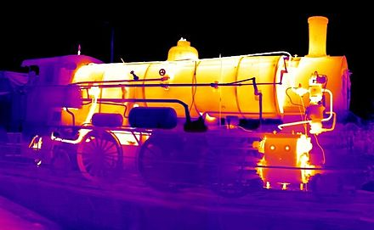
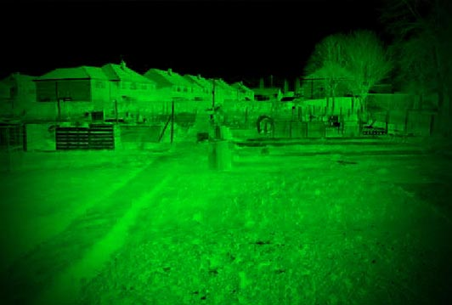
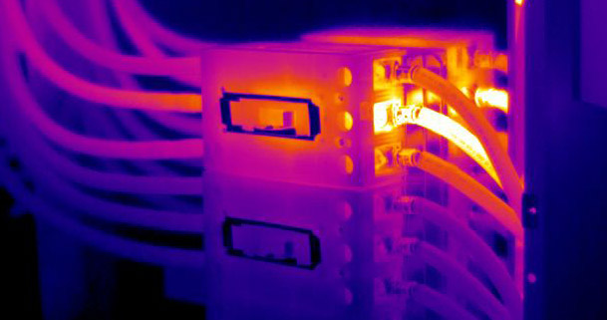
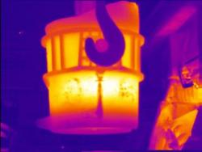
Applications
Diagnostics
Measurement and control
Medical diognosis
Night vision
Notes:
Cracks in the engine
Temp of the bucket of malten steel
Breast cancer detection
Night vision or targeting

Slide 4
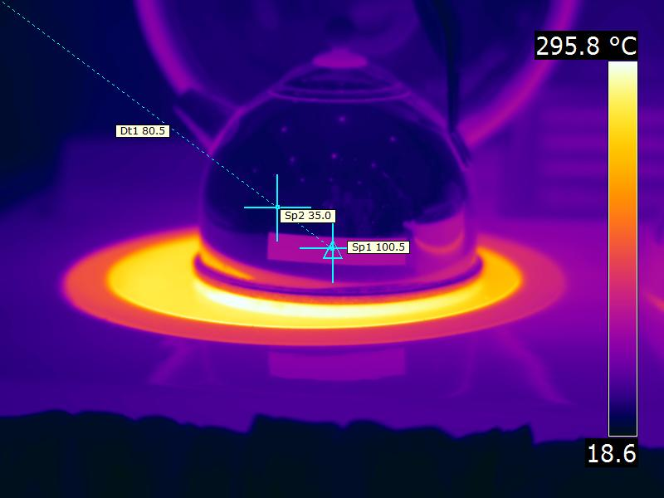
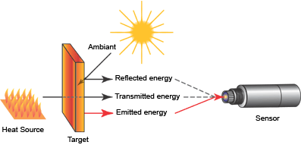
Harder than it looks
Emissivity
Notes:
Whats wrong with the picture?
Different sources of IR
Different materials are better or worse emitters nothing is perfect

